Slide 1

My Bank-Deposits Module
Revenue Rulers
Module:Deposits
-Akshira

Slide 2
Module Description
The Deposits Module is an integral part of MY Bank's banking system, facilitating management of both available deposits and deposits availed by customers. It encompasses functionalities related to the creation, management, and retrieval of deposit information, including details such as deposit ID, deposit amount, tenure, return of interest (ROI), deposit type, and description.
Key Features:
1. Deposit Available Management:. - Stores information about available deposits, including deposit ID, deposit amount, ROI, deposit type, and description. - Provides functionalities to search for available deposits based on deposit ID.
2. Deposit Availed Management: - Facilitates management of deposits availed by customers. - Stores information about deposits availed, including deposit ID, deposit amount, tenure, maturity, customer ID, and deposit ID. - Supports functionalities to create, update deposit availed records.
3. Search Functionality: - Enables users to search for available deposits based on deposit ID. - Retrieves deposit information from the database based on the provided deposit ID.
4. Calculator Service: - Provides a service for calculating the maturity deposit amount based on deposit amount, tenure, and return of interest. - Utilizes the simple interest formula: Maturity Amount = Principal Amount + (Principal Amount * Rate * Time).
Overall, the Deposits Module serves as a comprehensive solution for managing both available deposits and deposits availed, offering functionalities for retrieval, manipulation, and calculation of deposit-related information within MY Bank's banking system.

Slide 3
View Deposits Module
Upon the successful login ,the dashboard is displayed which contains the different modules.
On clicking the deposits ,we get the dropdown menu to view the deposits which displays all the available deposits in cards.
On clicking Know More ,the modal view is displayed with the deposit name as title and has the deposit roi ,depost type and description. It contains two buttons to apply the deposits and calculate the deposits.

Slide 4
Calculate Maturity Modue
On clicking the calculate Returns the calculator page is opened,which takes the deposit name and the roi from the card.
The user must enter the tenure and the amount to calculate the maturity amount.
The error messages will be displayed if the amount and tenure specified is invalid.
On clicking the calculate button the maturity amount will be calculated.

Slide 5
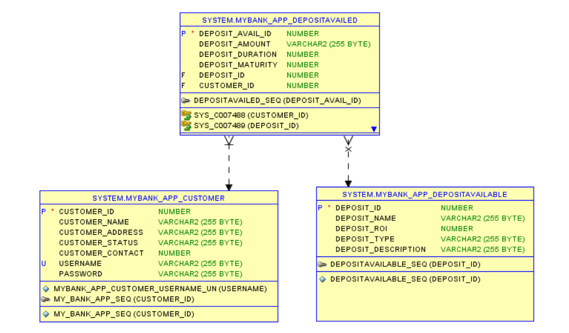
ER Diagram

Slide 6
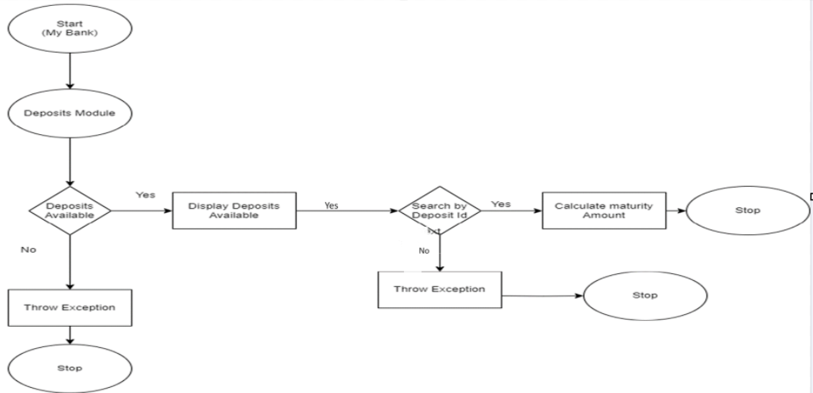
Flowchart

Slide 7
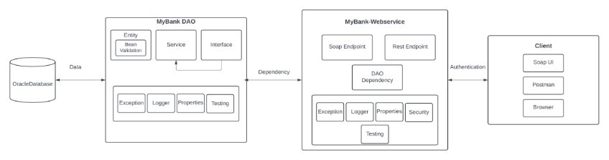
Architecture Diagram

Slide 8
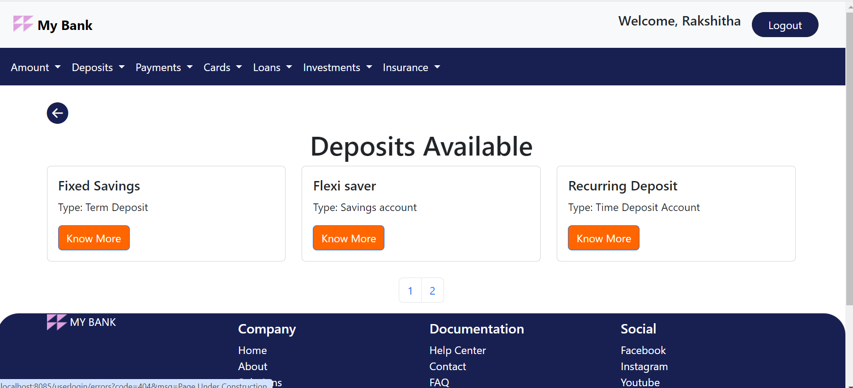
View Deposits Page

Slide 9
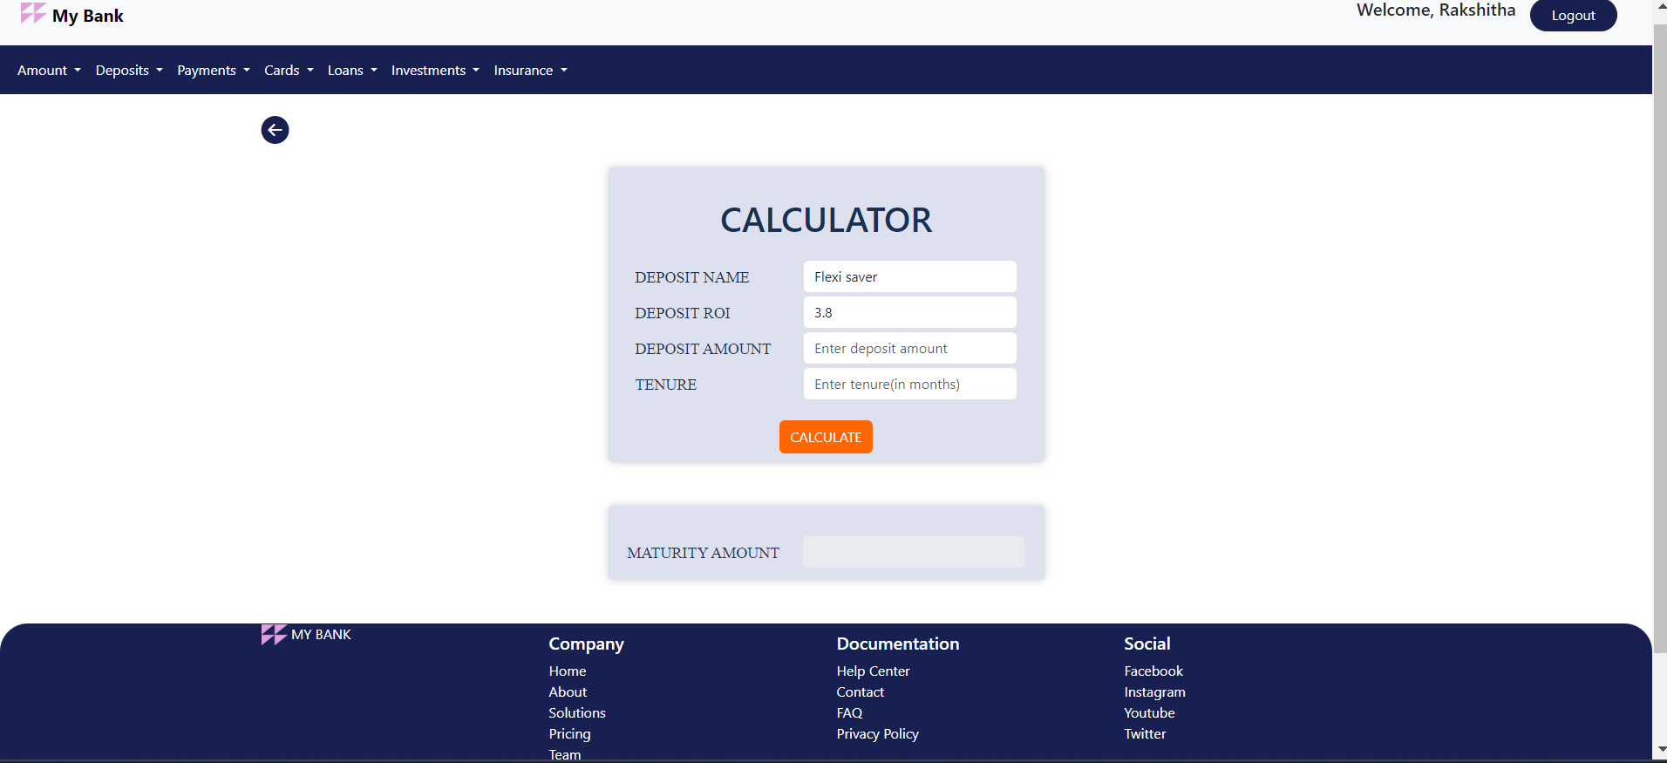
Calculator Page

Slide 10
Jar File mybankdeposit-0.0.1-SNAPSHOT.jar
Github Link
https://github.com/Akshirahegde/DLTE-JAVA-FULL-STACK-AKSHIRA-2024/tree/master/DLTE-MYBANK-PROJECT

Slide 11
THANK YOU

